Slide 1
GITHUB
SUBMITTED BY :- ABHISHEK
BRANCH:-CSE
ROLL NO:-2322007
SUBMITTED TO:- Mr. DEVASHISH SIR

Slide 2
GIT COMMANDS
INITIALIZE :-
initialize a new git repositiory in working directory
ADD :-
add changes in working directory to staging area
COMMIT :-
save changes from staging area to local repository in Git
PUSH :-
upload local repository content to a remote. Eg. GitHub
CLONE :-
clone a repository from GitHub onto a local machine

Slide 3
SETUP
Create a GitHub account :-
https://github.com/signup > enter details > confirm email
Install Git :-
Download and install Git from git-scm.com.
Check Git installation :-
On terminal (mac) or shell (window) or VS code (after VS code installation>tools menu>view>terminal
Install code editor (VS code) :-
https://code.visualstudio.com

Slide 4
Steps to make a GitHub account
Go to GitHub: Open your web browser and navigate to GitHub's website.
Sign Up: On the GitHub homepage, you'll see a "Sign Up" option at the top right corner. Click on it.
Enter Your Information:
Username: Choose a username that will be your unique identifier on GitHub. If your desired username is already taken, GitHub will prompt you to choose a different one.
Email Address: Enter your email address. This will be used for account-related notifications and communication from GitHub.
Password: Choose a strong password to secure your account.
4. Verify Your Account:
GitHub will send a verification email to the email address you provided.
Check your email inbox for the verification email from GitHub.
Click on the verification link in the email to confirm your email address.
5. Set Up Your Profile:
Once signed up, you can customize your profile by adding a profile picture, bio, and other details. This helps others identify you and learn about your interests.

Slide 5

HOME PAGE

Slide 6
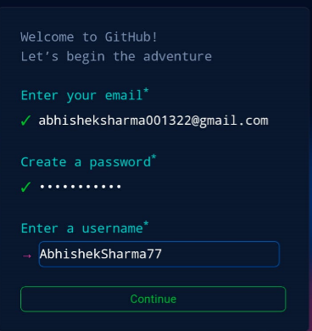
STEPS :-

Slide 7
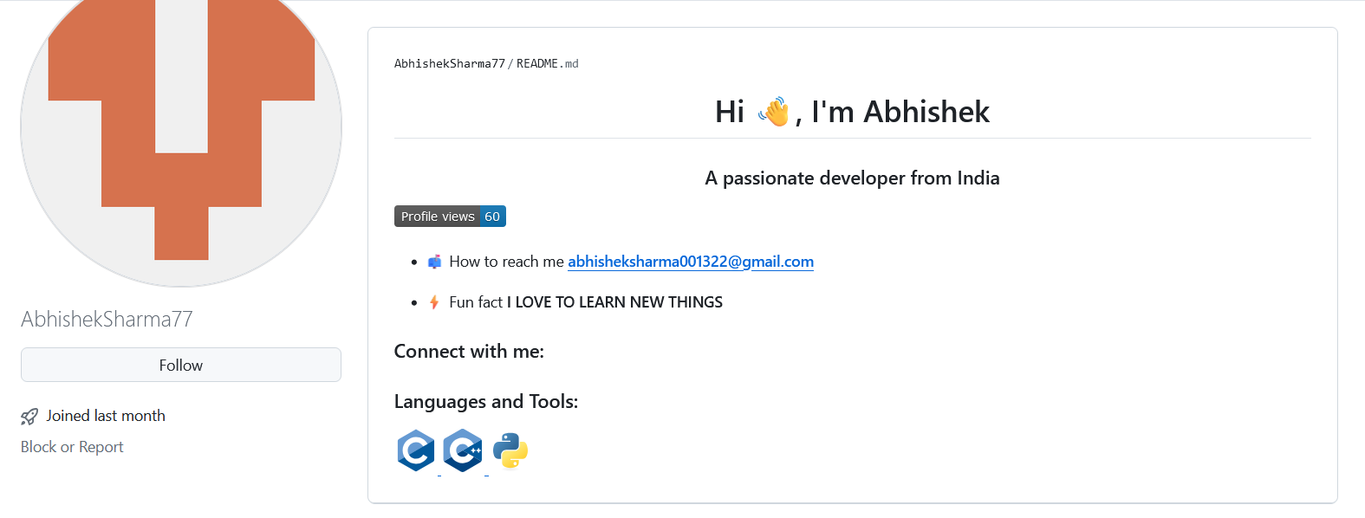
My GitHub Profile

Slide 8
Thank you

